Slide 1

Welcome to
WEB DESIGN
AND
DEVELOPMENT
Saturday - Thursday

Slide 2
I’AM
Mehedi Alam
Trainer of
Web Design and Development 01772050842
mehedialam806@gmail.com

Slide 4


Slide 5




Class Plan
HTML
CSS
Java Script
CSS Framework
UI/UX to Web
Final Project

Slide 6
Reference Website
https://w3schools.com/
https://webcoachbd.com
https://getbootstrap.com/
https://youtube.com/
https://google.com/

Slide 7




Essential Tools For Web Design
Editor/IDE [Integrated Development Environment]
Notepad ++ Sublime Text VS Code Atom
Php Strom

Slide 8





Essential Tools For Web Design
Browser / Server Mozilla Firefox Google Chrome Microsoft Edge
Editing Tools
Adobe Photoshop/Canva

Slide 9
You can call to Web Design in
many way
Web Design
Web Page Design
Web Site Design
Layout Design
Landing Page Design
Responsive Web/UI/Landing Page Design
Template Design
User Interface ( UI ) Design
Front End Design
Front End Development

Slide 10
Guideline for Frontend Developer
HTML
CSS
JavaScript (JS)
CSS Framework - Bootstrap / Tailwind
JS Framework - React JS / Vue JS / Angular JS
GIT System - Github / Gitlab
Adobe Photoshop, Figma, Canva

Slide 11
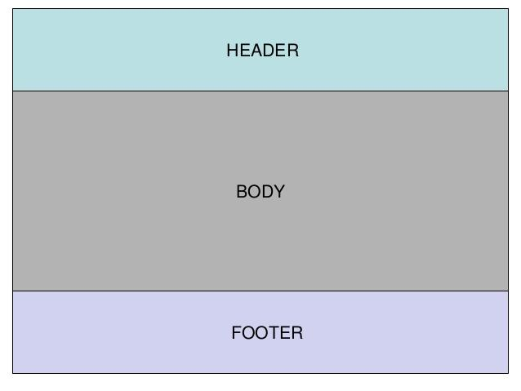
Web Page

Slide 12
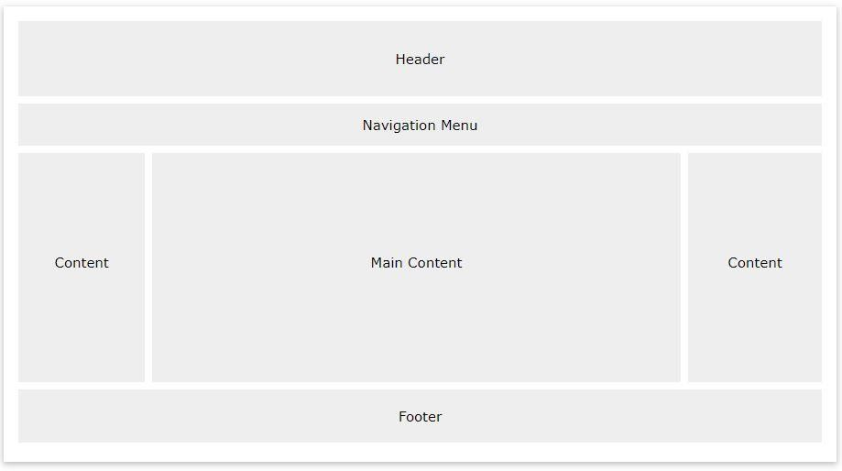
Web Page

Slide 13
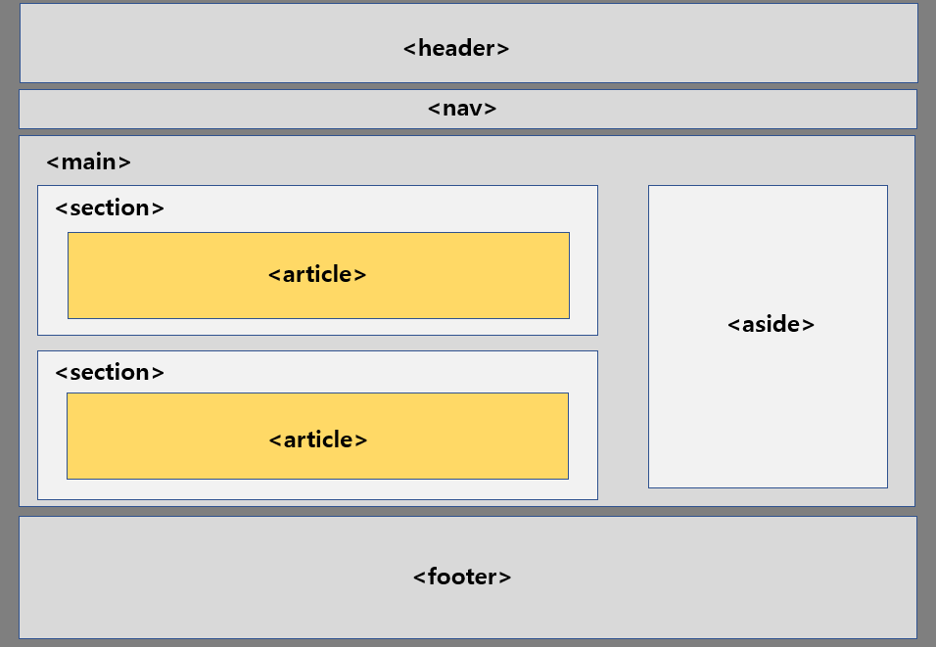
Web Page

Slide 14

Web Site

Slide 15
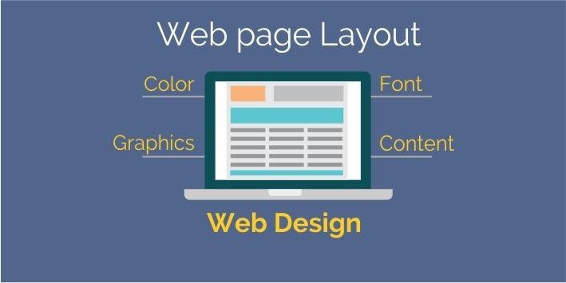
Web Design

Slide 16

Web Design

Slide 17
Part of Web Designing
Structure & Content [ HTML ]
Presentation
[ Css, JavaScript ]
Behavior [ Browser ]

Slide 18
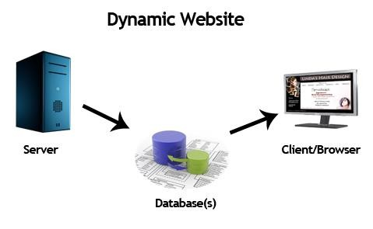
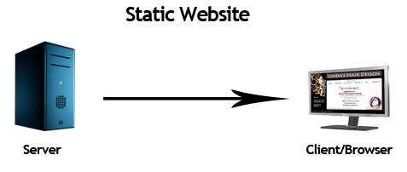
Type of Web Site
Static Website
Dynamic Website

Slide 19
Static Web Site
A static website contains Web pages with fixed content.
Each page is coded in plain HTML and displays the same information to every visitor. Unlike dynamic websites, they do not require any Web programming or database design.

Slide 20
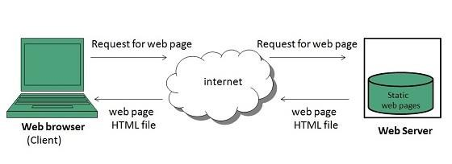
Static Web Site

Slide 21
Dynamic Web Site
Dynamic website is a collection of dynamic web pages whose content changes dynamically. It accesses content from a database. Therefore, when you alter or update the content of the database, the content of the website is also altered or updated.
Dynamic website uses client-side scripting such as JS or server-side scripting such as PHP, or both to generate dynamic content.
It may generate separate HTML for each request based on user request.

Slide 22
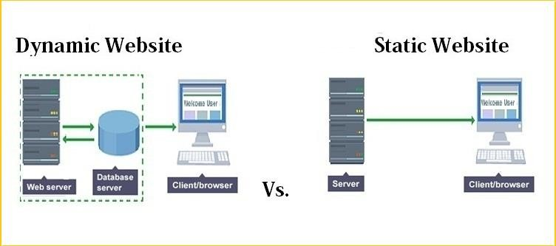
Static and Dynamic Web Site

Slide 23

HTML(Hypertext Markup Language)

Slide 24
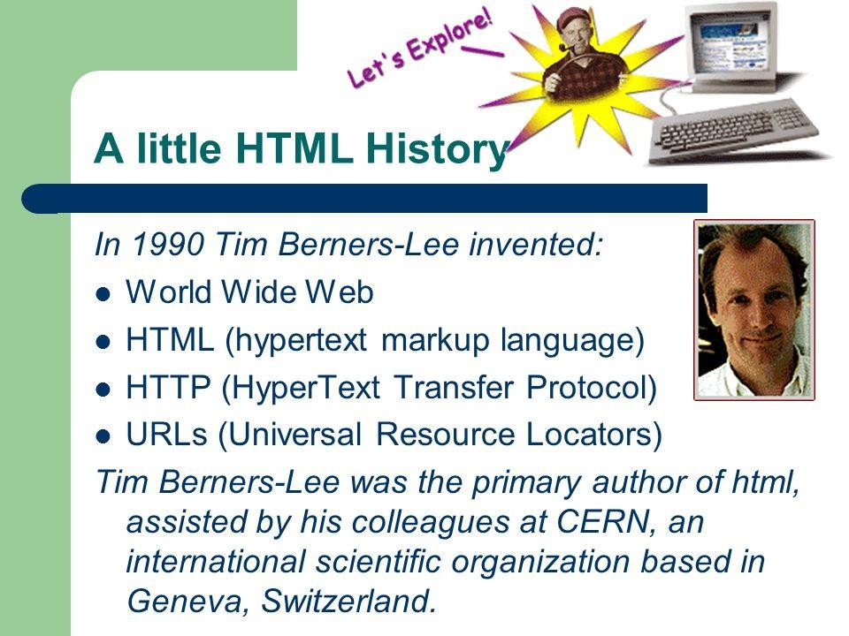
History Of HTML Version
HTML 1.0
HTML 2.0
HTML 3.0
HTML 3.2
HTML 4.01
XHTML 1.0
HTML5

Slide 25
About HTML
Hypertext Markup Language It’s a Tag based Markup Language, who build up website Structure and Content.
Sir Tim Berner’s Lee Invented HTML in 1989. First Developed HTML in 1990. First Version Of HTML released in 1991. Its Called HTML 1.0

Slide 26

HTML Tag
Hypertext Markup Language
Tag is a Syntax. It describes how to show anything in the browser.

Slide 27
Markup Language
All the tags are together called Markup Language

Slide 28
HTML Tag
<tag name >
< body>

Slide 29
HTML Tag
</tag name >
</ body>

Slide 30
HTML Tag
< tag name > …. < / tag name >
<p>Hello Bangladesh</p>

Slide 31
How many HTML tags are there?
Total Number of HTML tags
Reference Website | Total number of HTML tags
Mozilla Developer Network(MDN) | 142
HTML.com | 132
W3schools.com | 119
Eastmanreference.com | 115
Htmlreference.io | 113
Yourhtmlsource.com | 69

Slide 32
How many HTML tags are there?
Current usable HTML tags
These HTML tags are part of the current version of HTML (HTML5).
Reference Website | Total number Supported HTML tags
Mozilla Developer Network(MDN) | 111
Htmlreference.io | 113
W3schools.com | 107

Slide 33
HTML Element
An HTML element usually consists of a start tag and end tag, with the content inserted
in between.
<starting tag> ….. </ending tag>
<p> Welcome to BASIS-SEIP</p>

Slide 34
Nested Element
When an element, inserted between another element it is called
Nested Elements.
<head>
<title> Welcome </title>
</head>

Slide 35
HTML5 Structure
<!doctype html>
<html>
<head>
<meta charset=“UTF-8”>
<title>Professional Web Design</title>
</head>
<body>
<p> Welcome to BASIS-SEIP </p>
</body>
</html>

Slide 36
Doctype of Others HTML
Version | Doctype
HTML5 | <!doctype html>
HTML 4.01 | <! doctype HTML PUBLIC "-//W3C//DTD HTML 4.01 Transitional//EN" "http://www.w3.org/TR/html4/loose.dtd">
XHTML 1.1 | <! doctype html PUBLIC "-//W3C//DTD XHTML 1.1//EN" "http://www.w3.org/TR/xhtml11/DTD/xhtml11.dtd">

Slide 37




HTML Extension

Slide 38

Code Validation
You can validated your code using….
https://validator.w3.org/

Slide 39
HTML Standard
The World Wide Web Consortium (W3C.org)
W3C is the principle organization that sets standards for HTML

Slide 40
Heading Tag <h1> .. </h1>
<h1> h1 Heading </h1>
<h2> h2 Heading </h2>
<h3> h3 Heading </h3>
<h4> h4 Heading </h4>
<h5> h5 Heading </h5>
<h6> h6 Heading </h6>

Slide 41
Paragraph Tag <p> .. </p>
<p> Basis Institute of Technology and Management </p>

Slide 42
Example of Paragraph Tag <p> .. </p>
<html>
<body>
<p>
NetBeans Community Distributions are available under a Dual License consisting of the Common Development and Distribution License (CDDL) v1.0 and GNU General Public License (GPL) v2. Such distributions include additional components under separate licenses identified in the License file. See the Third Party License file for external components included in NetBeans and their associated licenses.
</p>
<p>
NetBeans Community Distributions are available under a Dual License consisting of the Common Development and Distribution License (CDDL) v1.0 and GNU General Public License (GPL) v2. Such distributions include additional components under separate licenses identified in the License file. See the Third Party License file for external components included in NetBeans and their associated licenses.
</p>
</body>
</html>

Slide 43
Formatting Tag
<b> - Bold text </b>
<strong> - Important text </strong>
<i> - Italic text </i>
<em> - Emphasized text </em>
<u> Underline Text </u>
<mark> - Marked text </mark>

Slide 44
Formatting Tag
<del> - Deleted text </del>
<ins> - Inserted text </ins>
<sub> - Subscript text </sub>
<sup> - Superscript text </sup>
<small> - Small text </small>
<br/> - Inserts a single line break
<hr/> - line in text

Slide 45
Pre - Formatting Tag
<pre>
Defines pre-formatted text
</pre>

Slide 46
HTML Quotation and Citation Elements
Abbr - Defines an abbreviation or acronym
Address - Defines contact information for the author/owner of a document
Bdo - Defines the text direction
Blockquote - Defines a section that is quoted from another source
Cite - Defines the title of a work
Q - Defines a short inline quotation

Slide 47
HTML <q> for Short Quotations
Browsers usually insert quotation marks around the <q> element.
Example:
<p> WWF's goal is to:
<q>Build a future where people live in harmony with nature.</q>
</p>

Slide 48
HTML < blockquote> for Short Quotations
<p>Here is a quote from WWF's website:</p>
<blockquote cite="http://www.worldwildlife.org/who/index.html">
For 50 years, WWF has been protecting the future of nature. The world's leading conservation organization.
</blockquote>

Slide 49
HTML <abbr> for Abbreviations
Marking abbreviations can give useful information to browsers, translation systems and search-engines.
Example:
<p>The <abbr title="World Health Organization">WHO</abbr> was founded in 1948.
</p>

Slide 50
HTML <address> for Contact Information
<address>
Written by John Doe.<br> Visit us at:<br> Example.com<br>
Box 564, Disneyland<br> USA
</address>

Slide 51
Attribute
Attributes provide additional information about HTML elements.. In HTML syntax, an attribute is added to an HTML start tag.

Slide 52
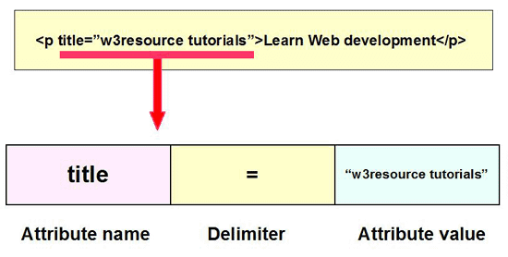
Attribute

Slide 53
Attribute Condition
Attribute name and values separated by an
Equal [ = ] Sign
Multiple Attribute separated by a space

Slide 54
HTML Comment Tags
<!-- Write your comments here -->

Slide 55
Link / Path
Link / Path 2 Types:
Absolute Path/Link
Absolute Path : D:/BASIS/BITM/banner.jpg
Absolute Link : http://bitm.org.bd/uploads/1416831456.jpg
Related Path/Link
Related Path : ../bitm/banner.jpg
Related Link : XXXXXXXXXXXXX

Slide 56
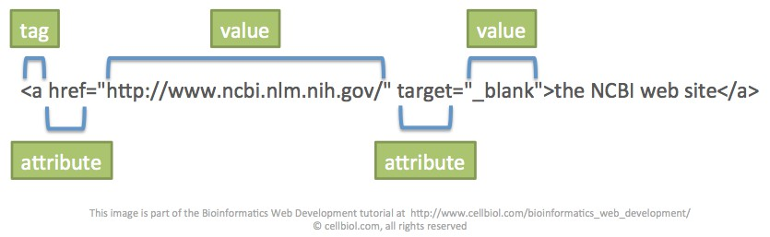
A Tag

Slide 57
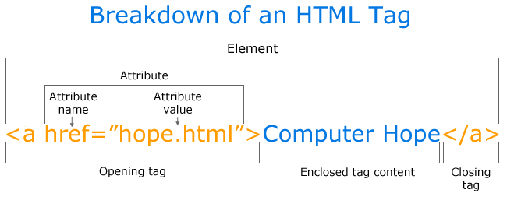
A Tag

Slide 58
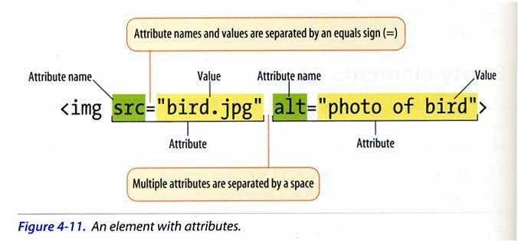
Image

Slide 59
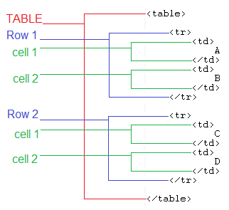
Table

Slide 60
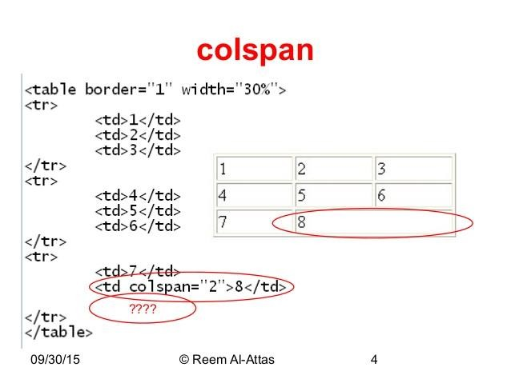
Table Colspan

Slide 61
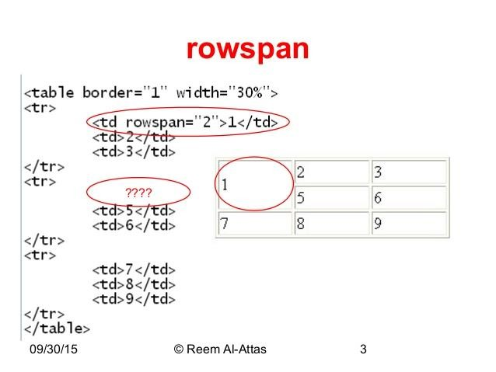
Table Rowspan

Slide 62
Some Sequence Format
Tag -> attribute = “attribute value ”
Tag -> attribute -> properties =“Properties value ”
Table -> tr -> td/th
Tr = Table Row
Td = Table Data
Th = Table Head
Td / th / cell all are same

Slide 63

Favicon
<head>
<title> Page Title</title>
<link rel="icon" href=“assets/image/favicon.ico">
</head>

Slide 64

Practice! Practice! Practice!!!

Slide 65

Mehedi Alam – mehedialam806@gmail.com - NHRDF

